Slide 1

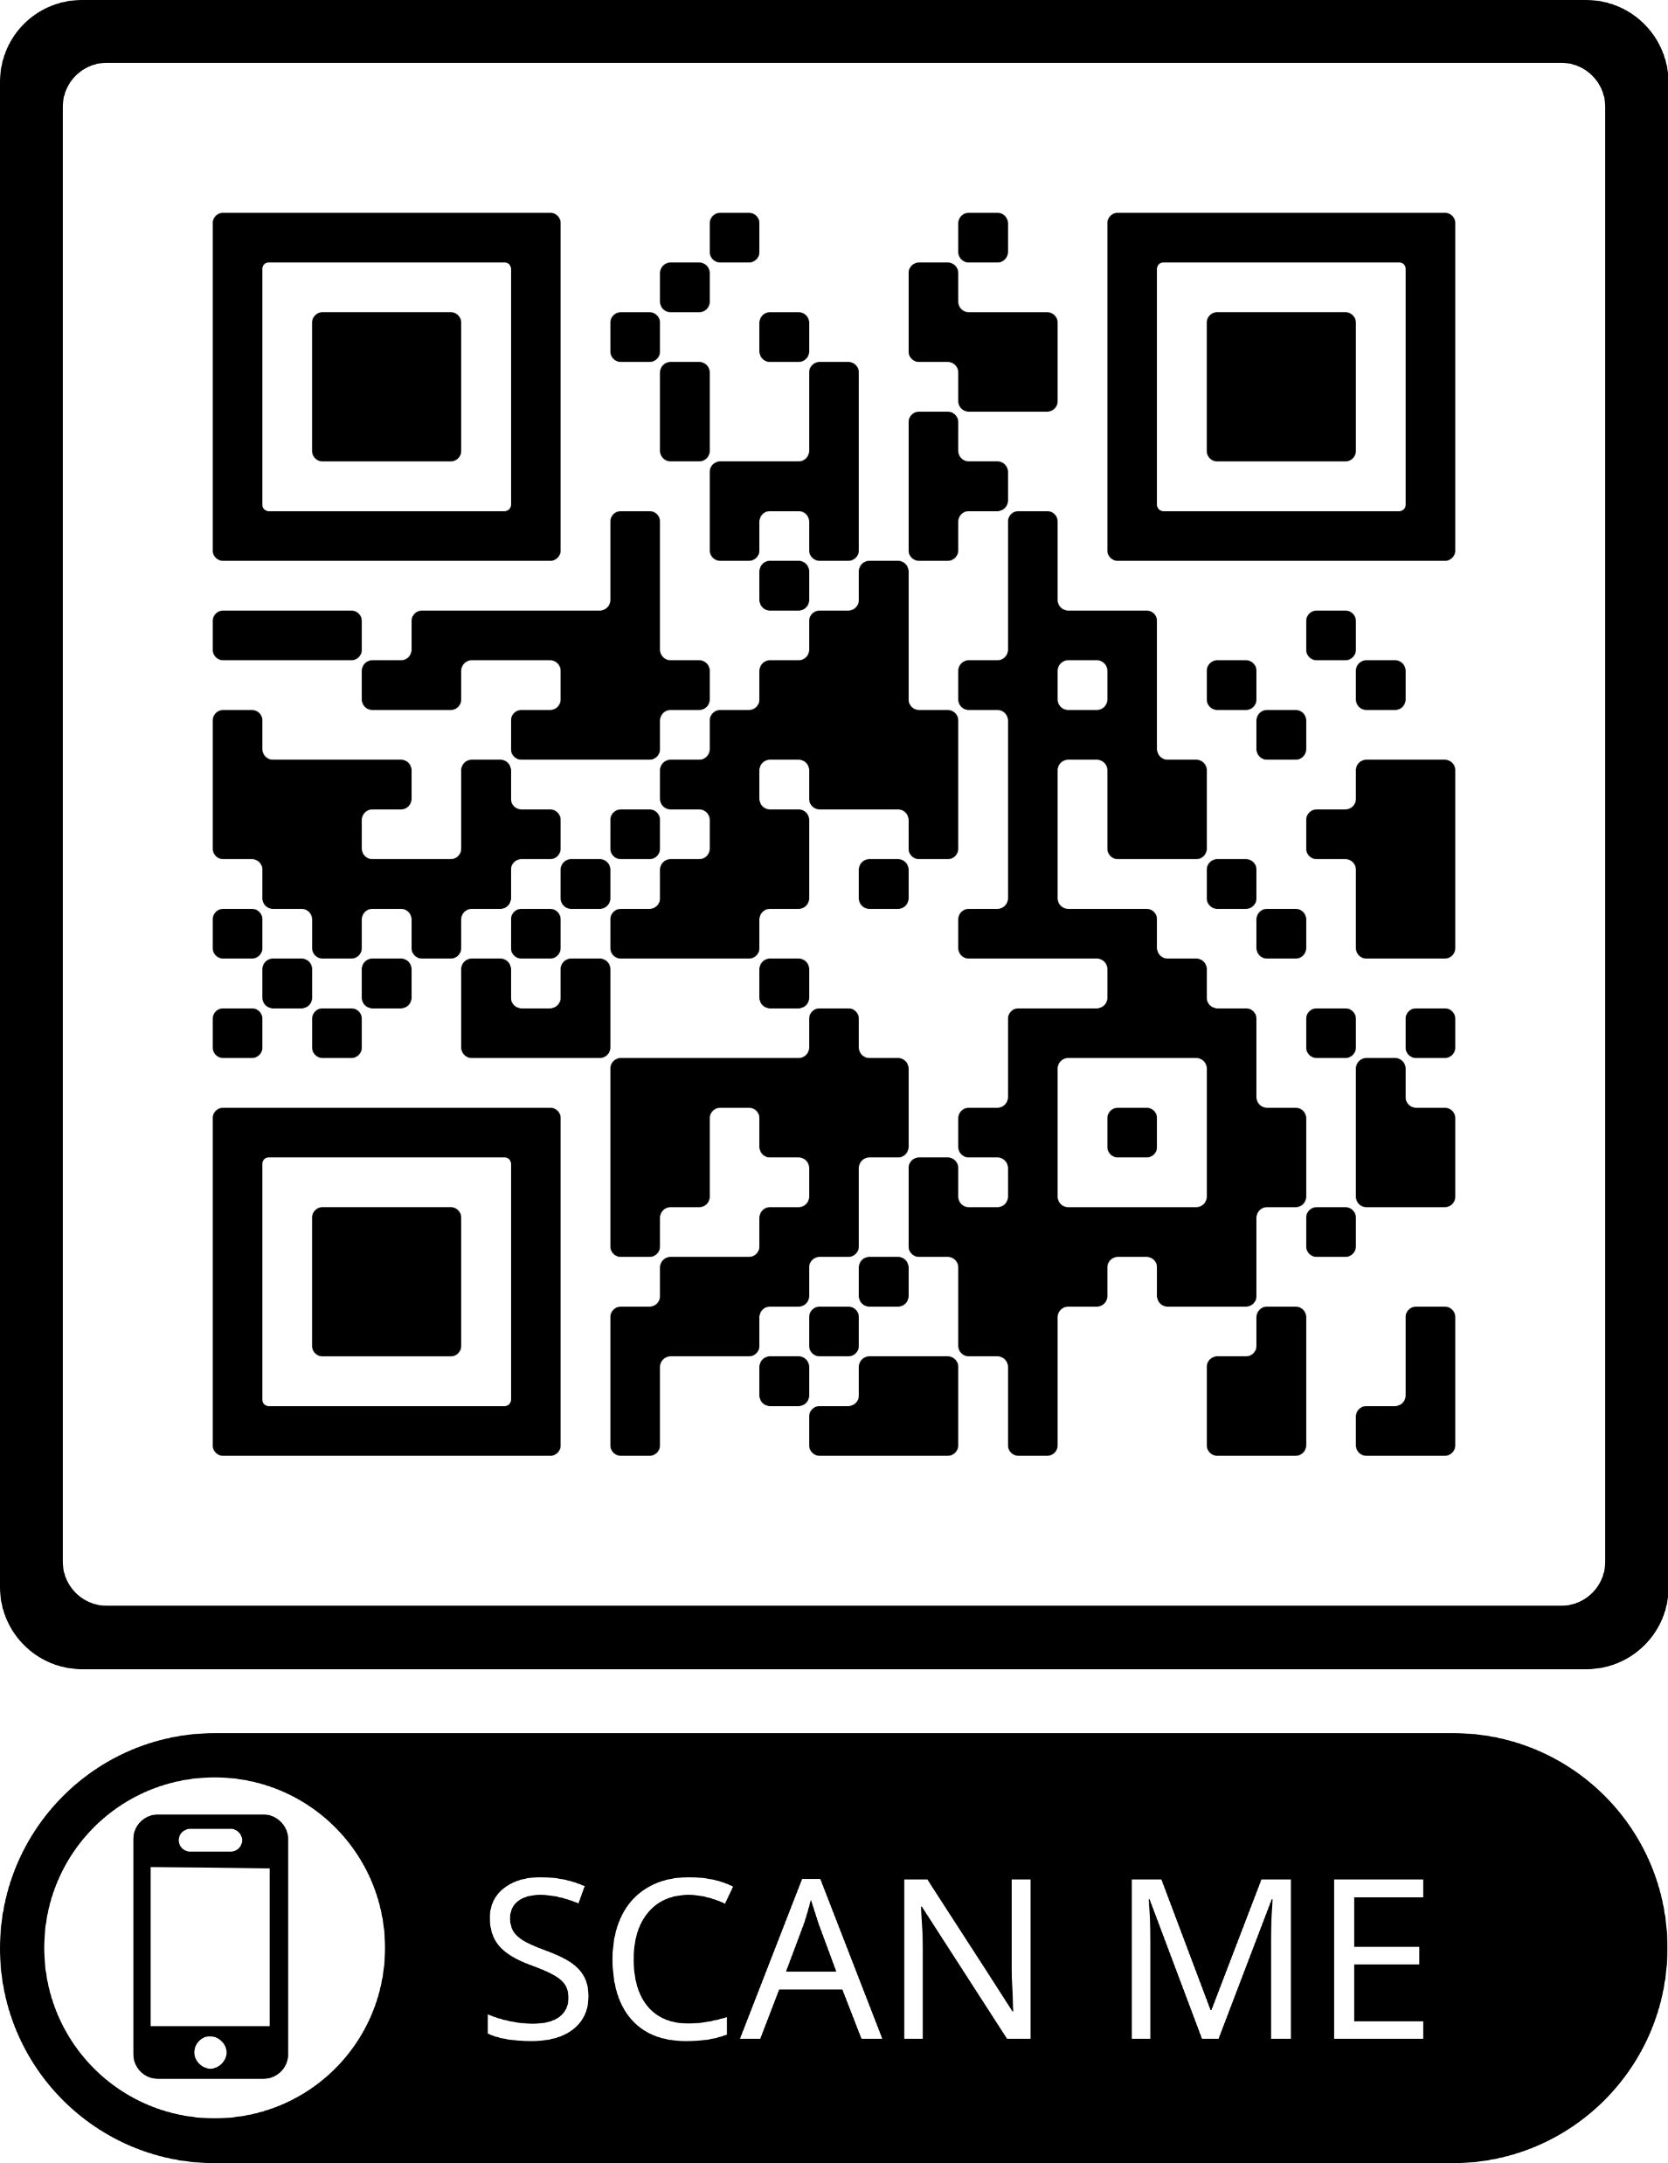
Final Android Project (FAP)
Mqtt App
https://github.com/A00287845/Final-Project

Slide 2
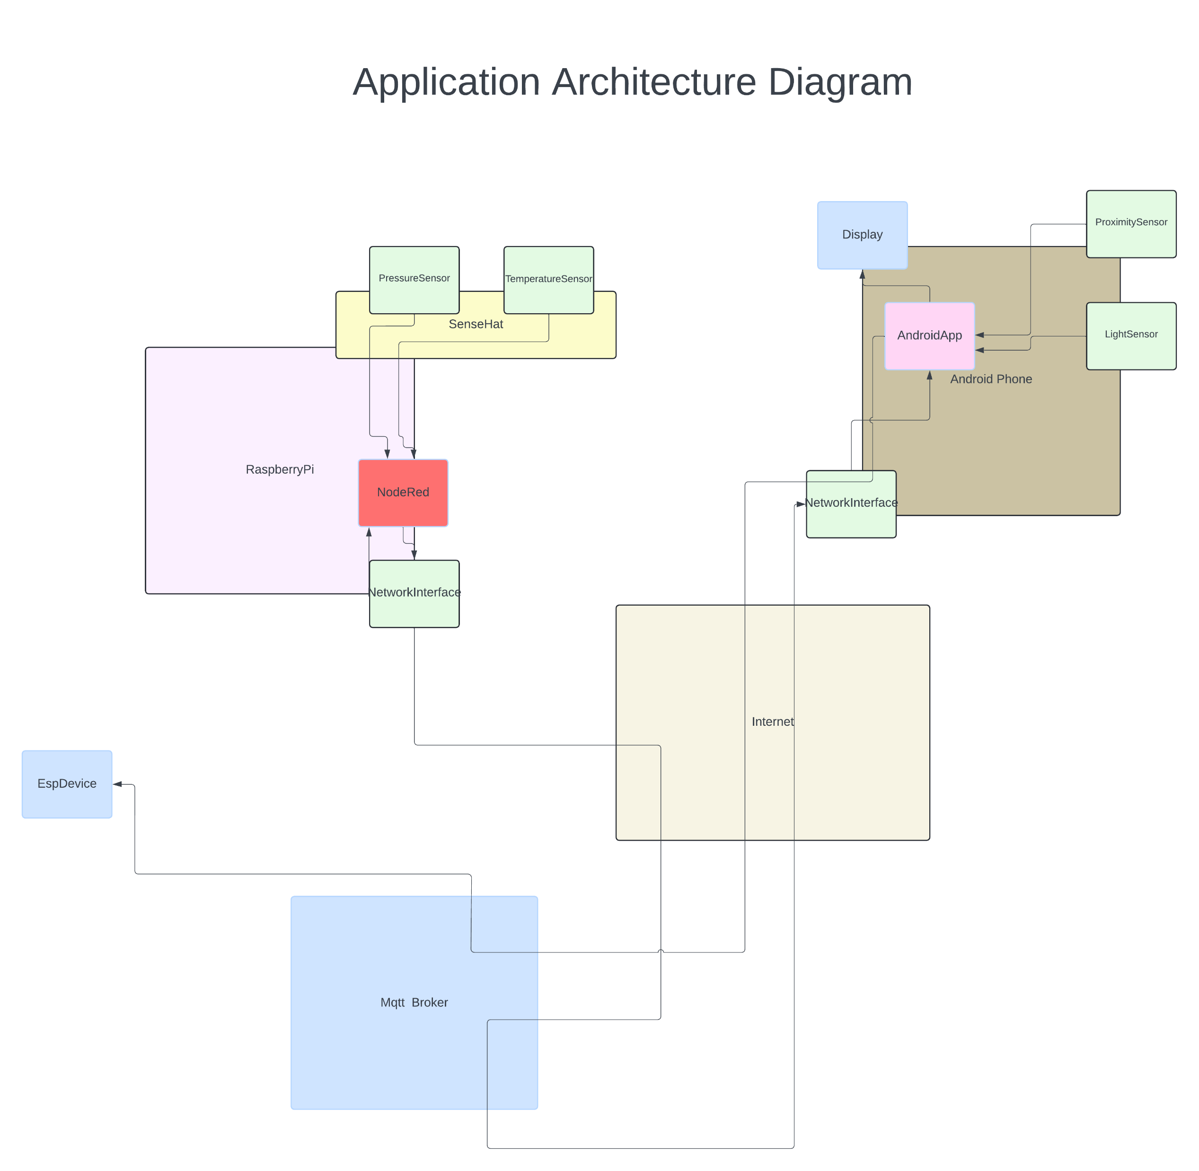

Slide 3


Slide 6
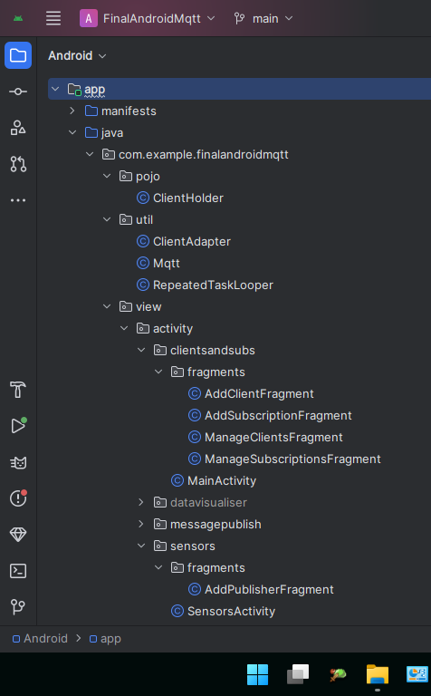

Slide 7
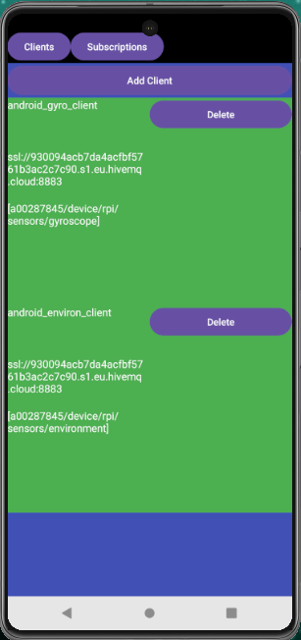

Slide 8
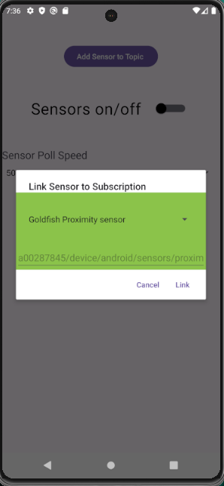

Slide 9

Questions?

